Slide 1
Day and Night

Slide 2
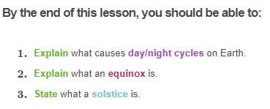
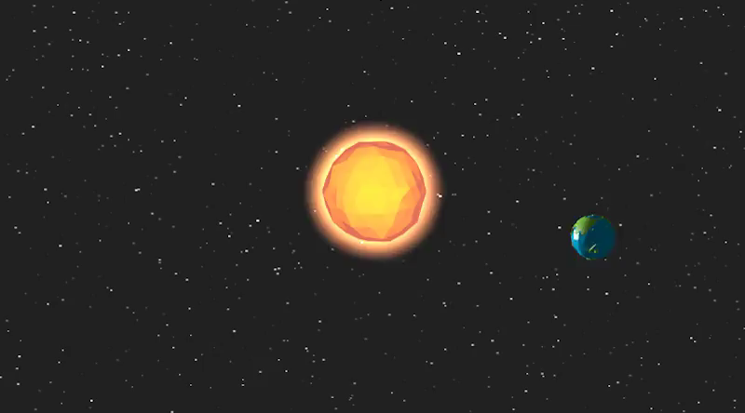

Slide 3
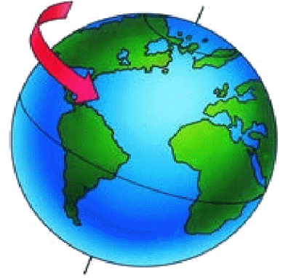
An imaginary line called the axis runs through the Earth from the North Pole to the South Pole.
Earth rotates around this line from west to east.

Slide 4
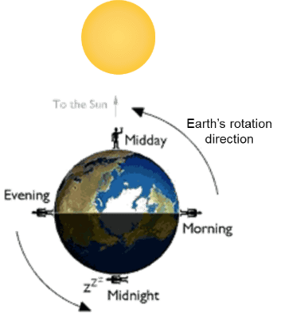
The time taken for any planet to rotate about its axis is referred to as a day.
Earth takes 24 hours to complete a full rotation, therefore one day on Earth is 24 hours.
If it was midnight in Australia right now, the time taken for Earth to complete one full rotation and come back to midnight again is 24 hours.

Slide 5

At any time, half of Earth is bathed in sunlight.
This half of Earth experiences daylight. The other half is in the dark and so experiences night. As the Earth rotates, some countries move into the light while others move out of it.

Slide 6
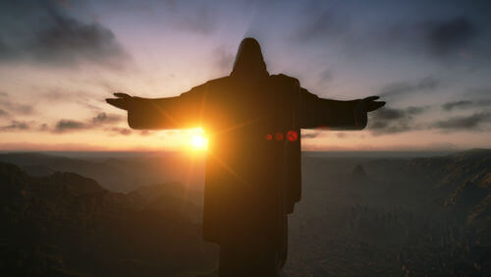
For example, when it is midday in Brisbane, it is midnight in Rio de Janeiro, Brazil.
When the Sun is setting in Brisbane, the Sun is rising in Rio de Janeiro, and when the Sun is rising in Brisbane, the Sun is setting in Rio de Janeiro.

Slide 7
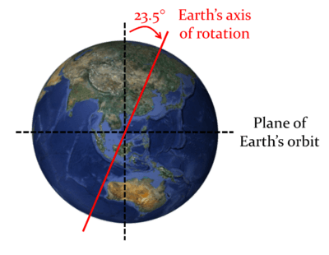
The Earth's axis is tilted!
The Earth's axis is tilted on an angle of 23.5∘ from vertical. This means that as the Earth rotates on its axis, some parts of the Earth get more sunlight than others.

Slide 8
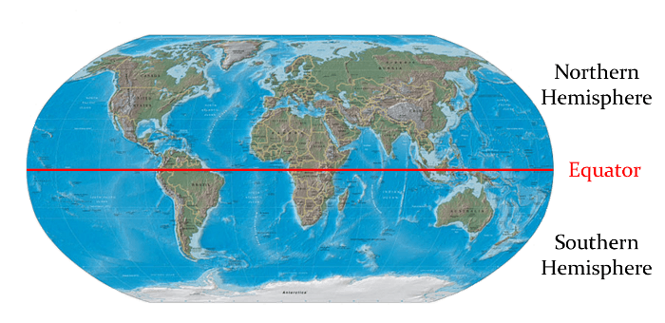
Australia is in the Southern Hemisphere.
When the South Pole is tilted away from the Sun, Australia experiences winter. When the South Pole is tilted towards the Sun, Australia experiences summer.

Slide 9
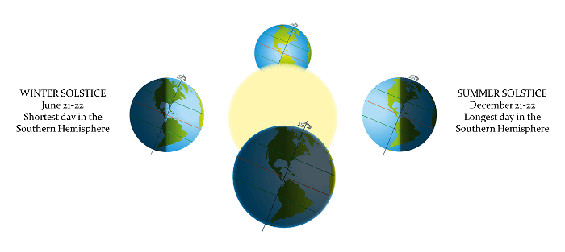
A solstice occurs when the ends of the Earth's axis are at their closest or furthest point from the Sun.
There are two solstices per year: the winter solstice and the summer solstice.

Slide 10
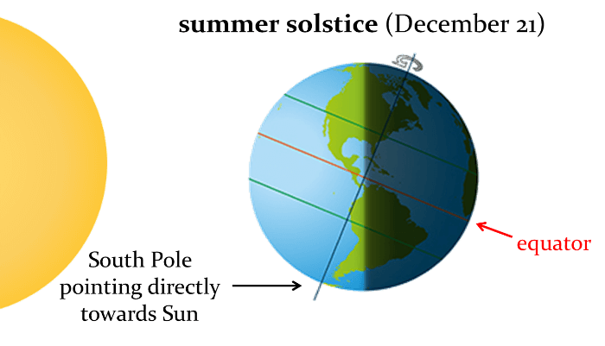
Summer solstice
Since Australia is in the southern hemisphere, the summer solstice occurs when the South Pole reaches the closest point to the Sun due to the Earth's axis of rotation.
This occurs on December 21 or 22 every year, and it is the longest day of the year. Australia gets more than 15 hours of daylight on the summer solstice!

Slide 11
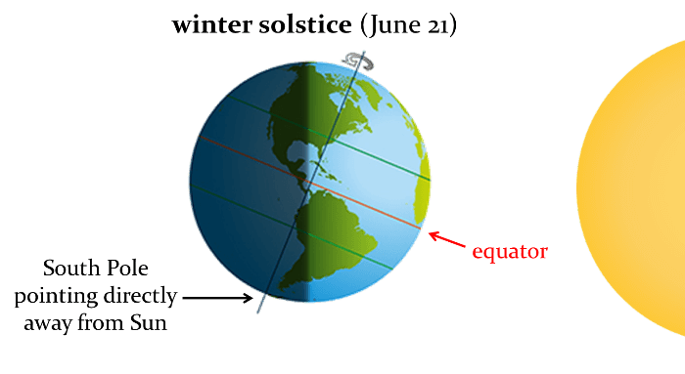
Winter solstice
The winter solstice occurs when the South Pole reaches the furthest point from the Sun due to the Earth's axis of rotation.
This occurs on June 21 or 22 every year, and it is the shortest day of the year. Australia gets just over 9 hours of daylight on the winter solstice.

Slide 12
Equinox
As the Earth moves around its orbit, it reaches two points during the year where its axis is tilted neither towards nor away from the Sun.
On these two days, the whole planet experiences approximately 12 hours of daylight and 12 hours of darkness. These days are known as equinoxes because day and night are of equal length.

Slide 13
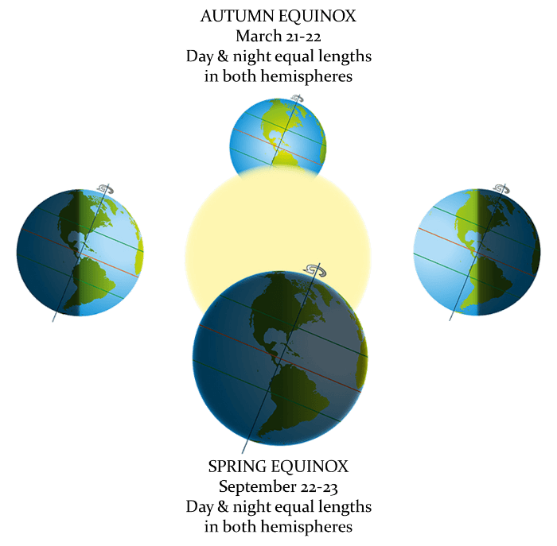

Slide 14
